Slide 1
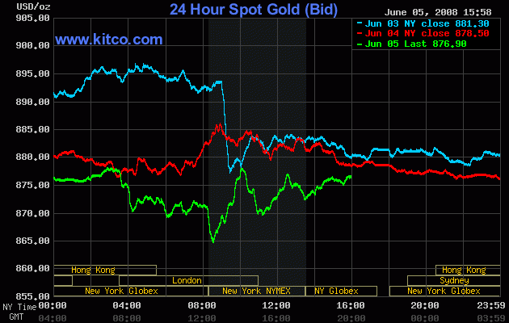
Stock Price Prediction and Classification
A Project by Nicholas Catani

Slide 2

Table of Contents
Introduction
Libraries
Stakeholders
Data Preparation and Exploration
Business Questions
Training Session
Conclusion
Ethical Implications
Future Directions

Slide 3



Introduction
Biz reasons
Objectives
Dataset Attributes
In the global economy, understanding and predicting stock prices are crucial for financial success
The Project focuses on historical stock price data analysis and modeling.
Exploration: Uncover patterns, relationships, and insights in the dataset.
Prediction: Use machine learning to predict stock prices and classify future stock performance.
Date, opening/closing prices, highest/lowest prices, volumes, dividend payments, stock splits.
Company details: brand names, ticker symbols, industry classifications, headquarters

Slide 4
Stakeholders
Who Would Benefit?
Investors: Gain insights for informed investment decisions.
Financial Analysts: Utilize data for comprehensive financial analyses.
Data Scientists: Leverage predictive models for stock market trends.
Business Executives: Understand industry and company performance.
Regulators: Monitor and assess market dynamics for regulatory purposes.
Why Does It Matter?
Informed Decisions: Enhances decision-making based on data-driven insights.
Risk Assessment: Provides valuable information for risk evaluation.
Market Understanding: Deepens understanding of market trends and dynamics.
Strategic Planning: Aids in formulating strategic plans based on industry and stock performance.

Slide 5
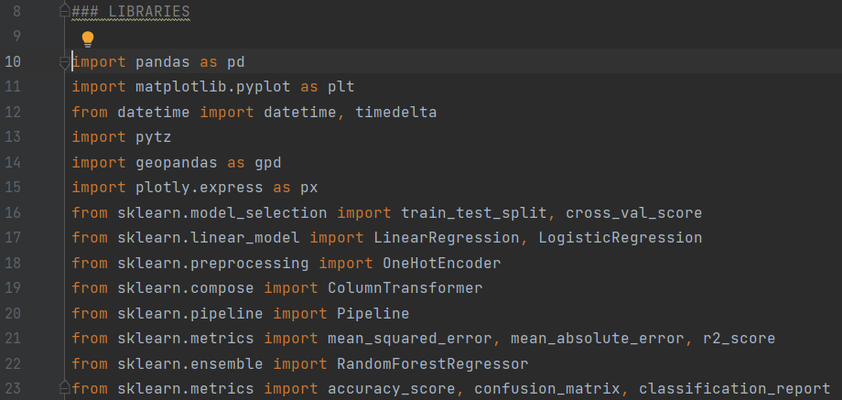
Libraries
Pandas: Data manipulation.
Matplotlib, Plotly: Data visualization.
Scikit-learn: Machine learning.
Geopandas: Handling geographic data.

Slide 6
Data Preparation & Exploration
Data Loading and Cleaning: - used pandas “read_csv” function. - applied “drop_duplicates” to ensure data integrity.
Feature Engineering: - converted “date” to datetime format. - created binary target variable “stock_going_down”
Exploratory Data Analysis (EDA): - used summary statistics, data visualization, and aggregation methods.

Slide 7
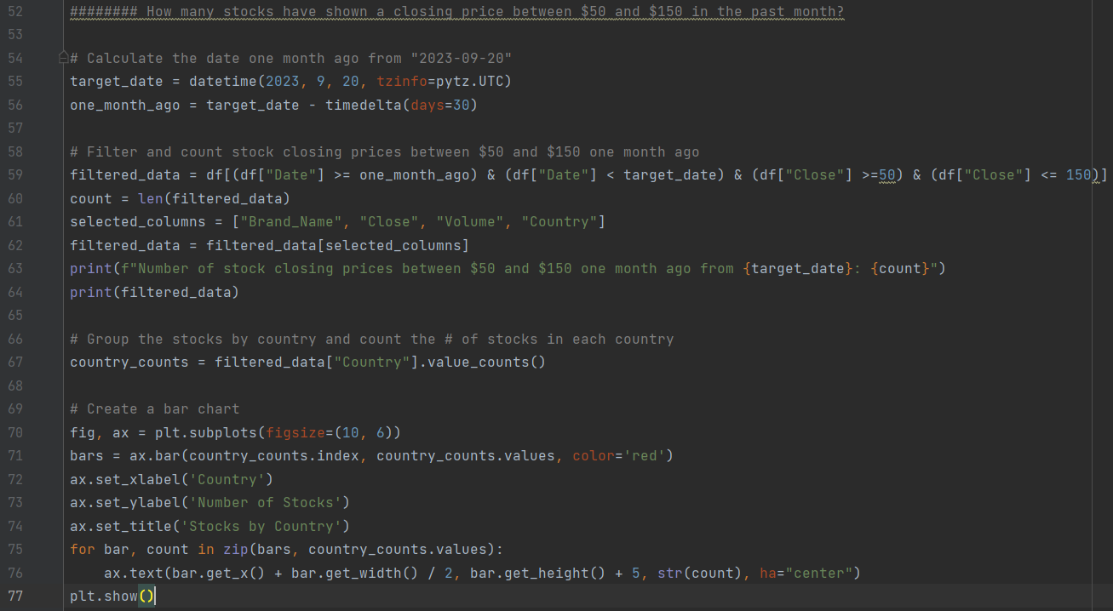
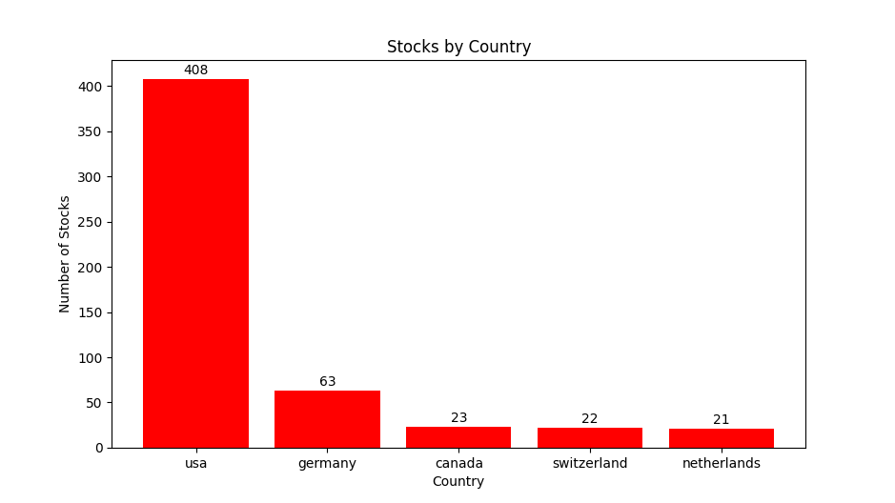
How many stocks had closing prices between $50 and $150 in the past month?

Slide 8
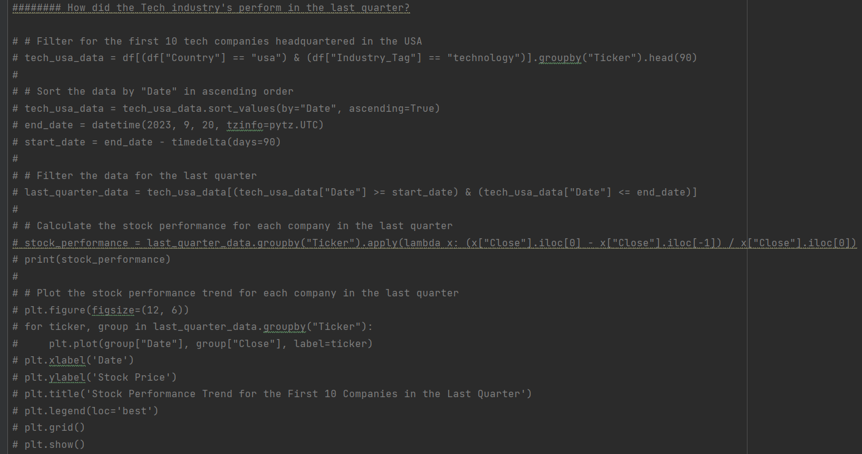
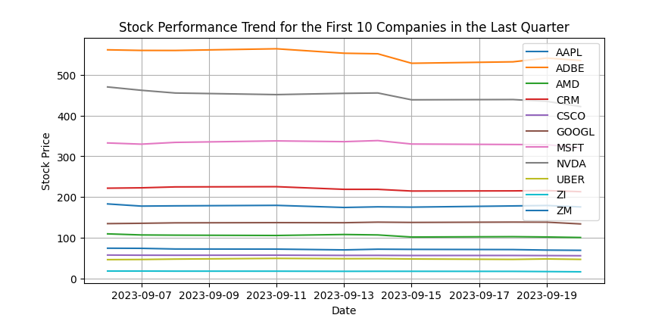
How did the Tech industry perform in the last quarter?

Slide 9
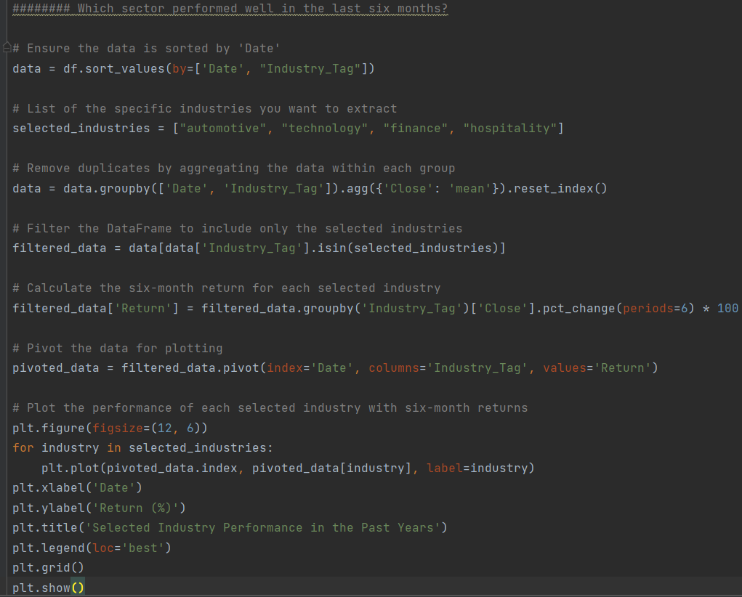
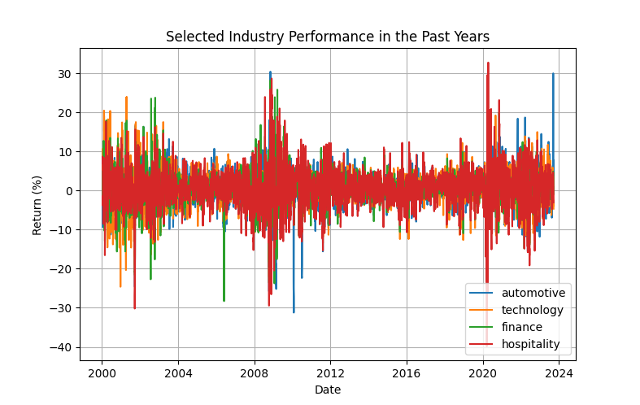
Which sector performed well in the last six months?

Slide 10
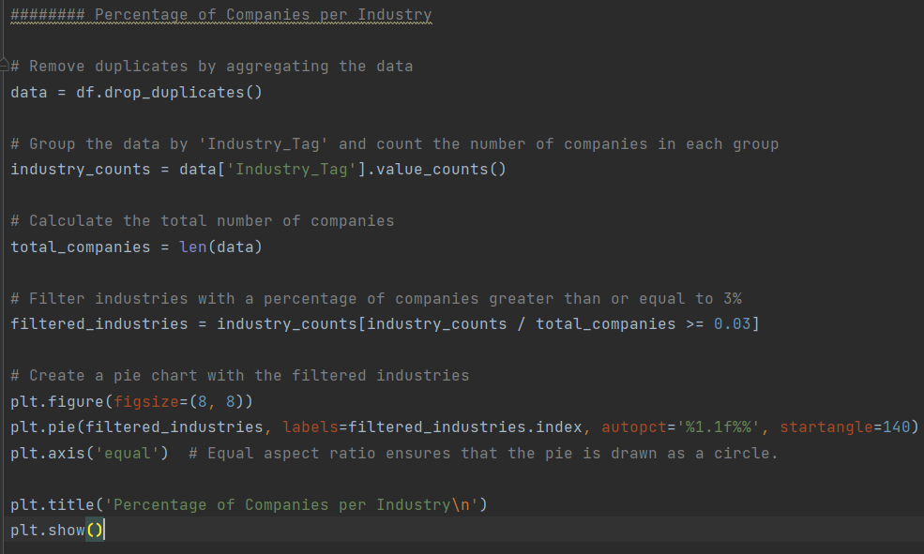
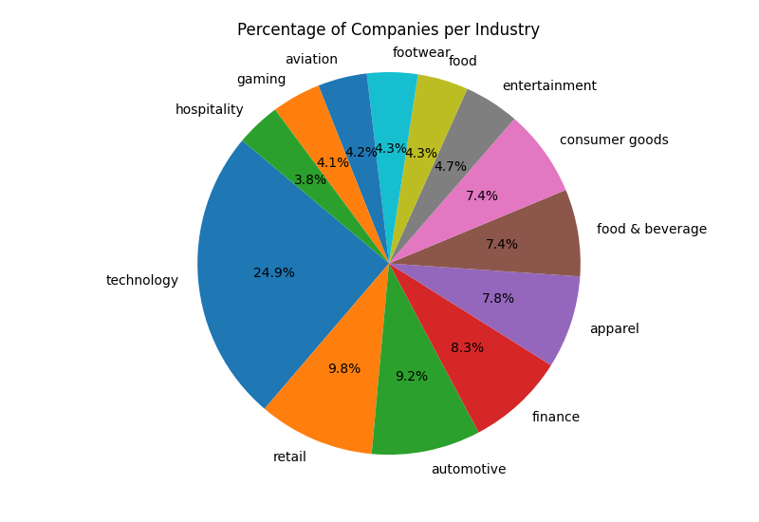
What is the percentage of companies per industry in the dataset?

Slide 11
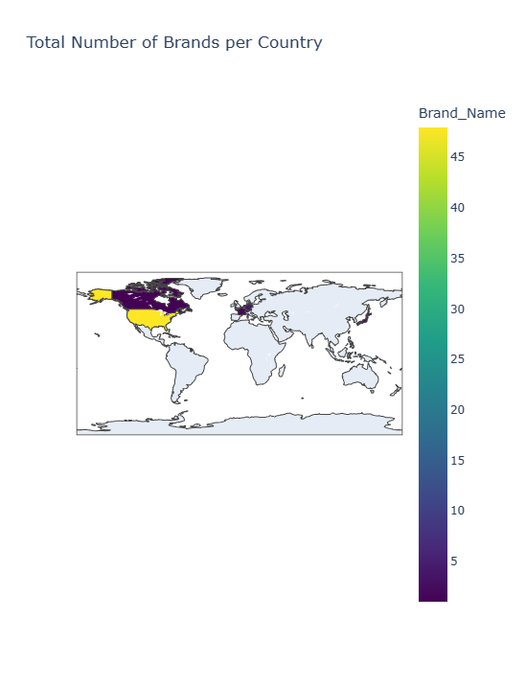
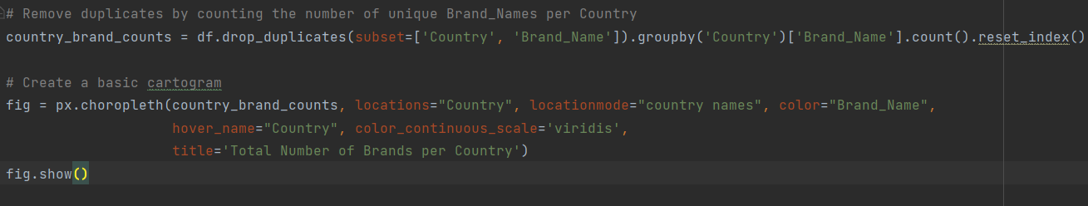
What is the total number of companies per country in the dataset?

Slide 12
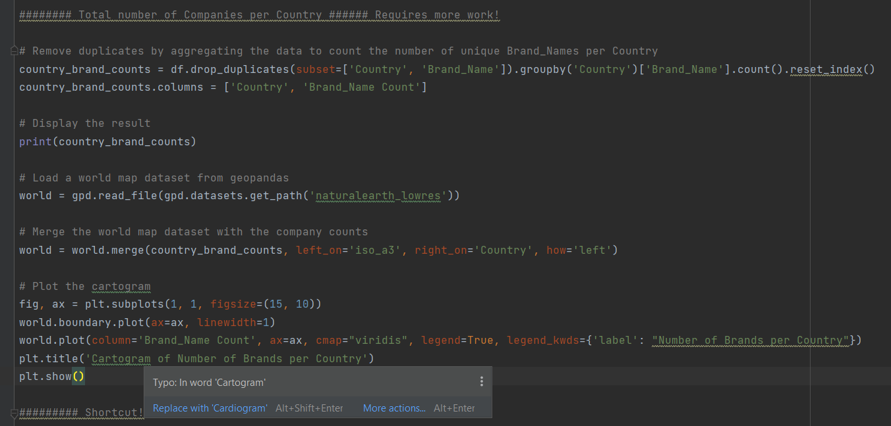


Slide 13
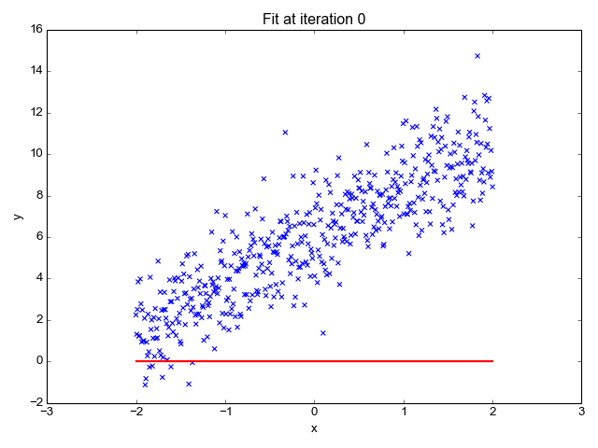
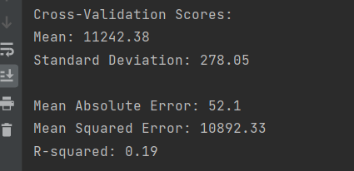
Linear Regression Model
Predicted “Close” stock prices.
Features included “High”, “Low”, “Volume”, “Dividends”, “Stock Splits”, and more.
Mean Absolute Error, Mean Squared Error, and R-squared

Slide 14
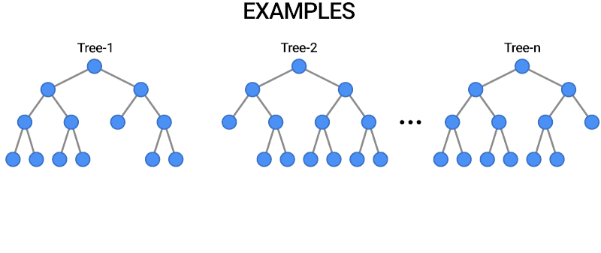
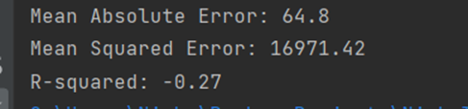
Random Forest Model
Ensemble of decision trees to predict stock prices.
Features included “Stock Splits”, “Dividends”, “Volume”.
MAE, MSE, and R-squared

Slide 15
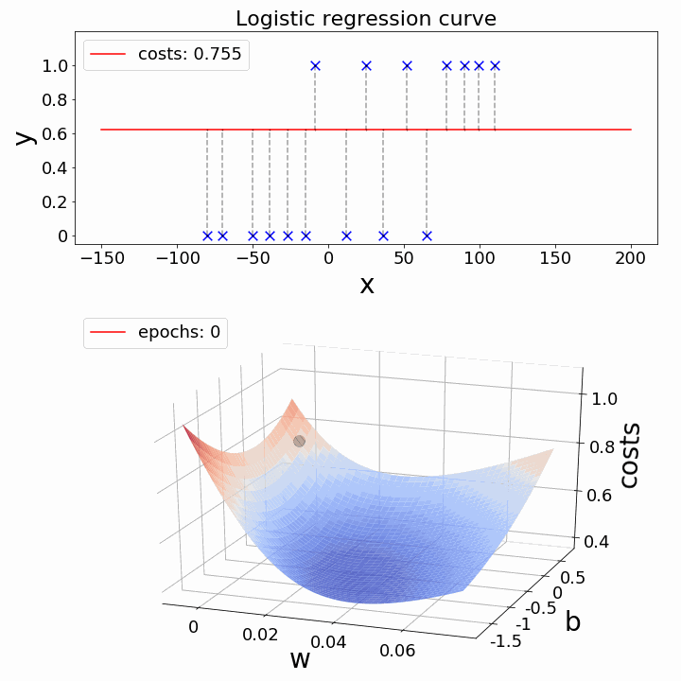
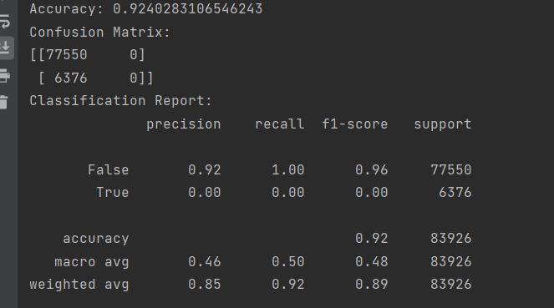
Logistic Regression Model
Predicted whether a stock’s price would decrease to zero.
Features included “High”, “Low”, “Volume”, “Dividends”
Accuracy, Confusion Matrix, Classification report.

Slide 16
Interpretations
Linear Regression:
Limited predictive power, potential need for further exploration or feature engineering.
Exploring more advanced algorithms may enhance predictive performance.
Random Forest:
Poor fit for the data, alternative approaches or feature engineering my improve accuracy.
Consideration of different model architectures or additional feature engineering is suggested.
Logistic Regression:
Excelled in predicting non-decreasing stocks but struggled with declining stocks.
Addressing class imbalance through oversampling, under sampling, or other algorithms recommended.

Slide 17
Ethical Implications
Insider Trading and Information Transparency
Fair Information Access: Ensure that analysis and predictions are based on publicly available information to prevent unfair advantages.
Avoid Insider Information: Strictly adhere to regulations to prevent the use of non-public information in decision-making.
Social Impact of Predictions
Market Influence: Acknowledge the potential impact of predictions on stock prices and market behavior.
Responsible Reporting: Exercise caution in reporting to prevent unintended consequences on investors and the market.
Environmental, Social, and Governance (ESG) Factors
Sustainable Investing: Consider integrating ESG factors into the analysis to promote socially responsible investing.
Transparency in ESG Metrics: Clearly communicate the criteria and metrics used for evaluating companies in terms of ESG.

Slide 18
Future Directions
Explore more advanced machine learning algorithms.
Conduct further feature engineering and refinement.
Continuous monitoring and adaptation to market dynamics.
Collaboration with domain experts for enhanced insights.

Slide 19

Any questions?

